Slide 1
Ch.13: Adjective Clauses
Part 3
Charts 9, 10, 11
Maling Lew

Slide 2
There are many colorful balloons ,
four of them are purple.
two of _____ are yellow.
three of _____ are red.
which
which
which

Slide 3
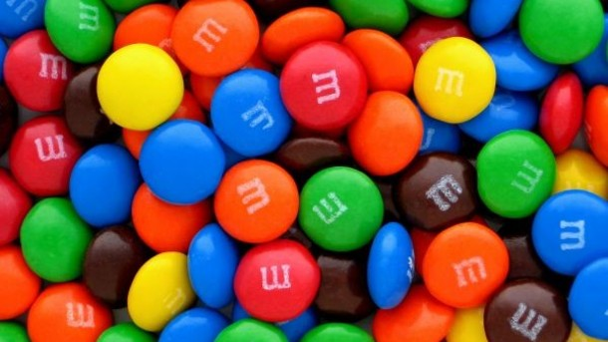
There are many m & ms ,
some of which are blue ,
many of which are orange ,
none of which are purple ,
all of which are delicious .

Slide 4
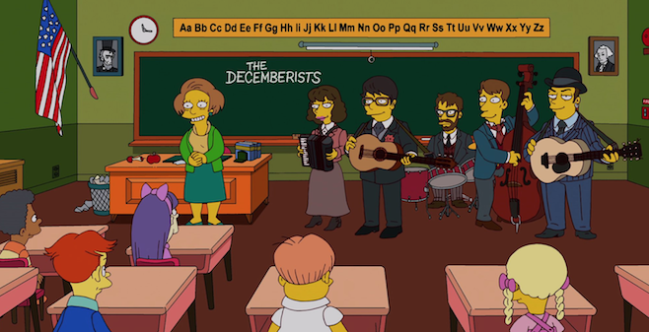
people
There are many people in the classroom ,
one of whom is the teacher ,
five of whom are students ,
several of whom are playing music.

Slide 5
13-9 Adjective Clauses with #s
Things: NOUN , # of which …
People: NOUN , # of whom …
Possessive: NOUN , # of whose + noun …
Always put a comma first!
There are 10 people in my family , half of whom live in California.
There are many places I want to visit , one of which is San Francisco.
There are many students in this class , some of whose grades are very good.

Slide 6
Complete the sentences with a partner.
I have many friends, all of…
whom are similar to me.
2. There are __ students in this class, some of…
3. There are many teachers in this program, several of…
4. There are many things I want to do during the long break, one of…

Slide 7
Do Ex. 43 (p. 290)
The city has 16 schools, two of which are…
…the orchestra played 2 symphonies, one of which was…
I tried on 6 pairs of shoes, none of which I…
The village has around 200 people, the majority of whom are farmers.
…has 5 employees, all of whom are…
After the riot, over 100 people, many of whom had been…, were taken to the hospital.

Slide 8
13-10 Adj Clauses can describe a whole sentence, too!
Tom was late. That really surprised me.
Tom was late , which really surprised me.
Some students cheated on the test.
It made Maling very sad.
Some students cheated on the test , which made Maling very sad.
RULES:
Use only “which”
Use a comma.
Adj clause goes at the end of sentence.

Slide 9
Combine sentences
1. Judy lost her job. That didn’t surprise me.
Judy lost her job, which didn’t surprise me.
2. She didn’t do her homework. That didn’t surprise the teacher.
She didn’t do her homework, which didn’t surprise the teacher.
3. Her boss fired her. That made her angry.
Her boss fired her, which made her angry.

Slide 10
13-11 Reducing Adjective Clauses
Reduce = to take away the subject + verb in the adjective clause
Ann is the woman who is crazy about cars.
Ann is the woman -- -- crazy about cars.
There are 2 ways you can reduce SUBJECT pronouns (who, which, that).

Slide 11
Way #1: If there is a be verb
→ remove the subject and be verb only
The man who is talking to John is from Korea.
The man -- -- talking to John is from Korea.
The stories which are told in the movie are good.
The stories -- --- told in the movie are good.

Slide 12
Practice:
Harry Potter, which was published in 2002, is my favorite book.
Harry Potter , which was published in 2002 , is my favorite book.
2) Albert Einstein, who was a great scientist, failed many tests in high school.
Albert Einstein , who was a great scientist , failed many tests in high school.

Slide 13
Way #2:
If adjective clause has no be verb
→ remove the subject and change the verb to -ing
Anyone who wants to come is welcome.
Anyone -- wanting to come is welcome.
Students who need help should talk to the teacher.
Students -- needing help should talk to the teacher.

Slide 14
Practice:
People [who visit the Taj Mahal] are impressed that a man built it to honor his wife.
People [ who visiting the Taj Mahal ] are impressed that a man built it to honor his wife.
2) Many students [who apply to Harvard] will be rejected.
Many students [ who applying to Harvard ] will be rejected.

Slide 15
Rule:
If the adjective clause has commas, keep the comma. Do not remove the comma.
Paris , which is the capital of France , is an exciting city.
Paris , -- -- the capital of France , is an exciting city.
Maling , who is my teacher , lives in Irvine.
Maling , -- -- my teacher , lives in Irvine.

Slide 16
Do Ex. 51 (p.295) #1-5 only
Do you know the woman coming towards us?
The scientists researching the causes of cancer are making progress.
We have an apartment overlooking the park.
The photographs published in the newspaper were extraordinary.
The rules allowing public access to wilderness areas need to be reconsidered.

Slide 17
Un-Reduce:
We visited Barcelona, a city in Spain.
We visited Barcelona, which is a city in Spain.
2. Any student not wanting to go on the trip should let the teacher know.
Any student who does not wanting to go on the trip should let the teacher know.
3. Be sure to follow the instructions given at the top of the page.
Be sure to follow the instructions which are given at the top of the page.

Slide 18
Homework
Exercise 58, p.299
Test on ___________! Study!

