Slide 1
Literary Terms for Short Stories
RW6
Maling Lew

Slide 2
Part I
Metaphor
Simile
Alliteration
Personification
Hyperbole
Irony

Slide 3
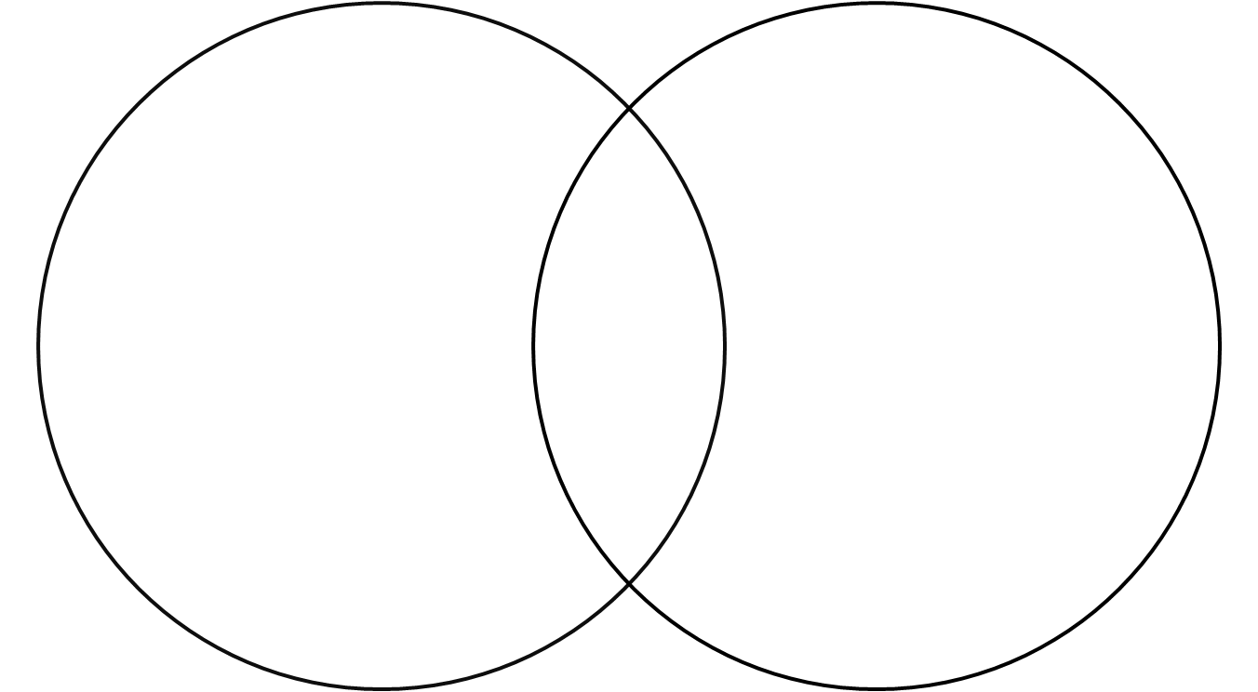
Metaphor
Comparing two things together that may at first seem dissimilar
Uses: A is B
Examples: A B
His words were poison.
She is a rock.
Life is a race.
No man is an island.

Slide 4
Choose one:
Love
Death
Dating
Teachers
Students
Words / language
Life
Failure
Americans
Mothers
Fathers
Babies / children
Teenagers
Traffic
Reading
Books
Your own word…. ☺

Slide 5
Class Metaphors ☺
Time is a sword.
Love is gold.
Children are animals.
Love is war.
Love is a trap. Marriage is a grave.
Life is a maze.
Books are oceans.

Slide 6
Simile
Comparing two things together that may at first seem dissimilar
Uses: A like / as B
Examples:
She is as cold as ice.
I am busy as a bee.
Her eyes are like diamonds.
Life is like a box of chocolates.

Slide 7
Class Similes ☺
Lets party like there is no tomorrow.
Teachers are like candles. They burn themselves to give us light.
Students are like sponges. They soak up knowledge.
Dating is like a competition.
California is hot as an oven
Schools are like jails.
Work for tomorrow as you live for ever.
He works as a clock.

Slide 8
Alliteration
Repetition of initial sounds in a series of words
Examples:
It was a snowy, silver, splendid scene.
Katie is cute as a kitten.
Karl was quick as a cat.
Alice's aunt always ate apples around August.

Slide 9
Class Alliterations ☺
Maling might make an appointment for a massage on Monday.
Can Crody can a can like a canner can can a can?
Thomas told Tom to tolerate Tony.
Song sees a spring during spring.
Lan likes living in a lovely land.
Yuki often yelled at young Yukie in youthful years.
Jeff just got justification from Jesus.
Lulu looks at the lock to see if the lock was/is locked.

Slide 10
Personification
Giving human qualities to things that are not human
The leaves danced in the wind.
The old house appeared depressed. ☹
She did not realize that death
was knocking at her door.

Slide 11
Personification examples
The cold winter took her frail life.
Death is watching you while you are smoking.
The wind gives you a hand when you are running.
The phone ran away from my hands.
Time slipped away.
The tornado sacked the city.
The flower is smiling at me.
Luck always fights me.

Slide 12
Hyperbole
An overstatement or exaggeration
Examples:
I left you a thousand messages.
I am so hungry I could eat a horse.
I have a million things to do.
I have a ton of homework.
If I can’t buy that new car, I will die.

Slide 13
Class Hyperboles ☺
I’m so tired / happy / angry / … I could ….
I’m so tired that I could sleep for days.
I’m so happy I could fly!
I’m so mad that I could kill someone.

Slide 14
Irony
Irony is the opposite of what is expected
Irony requires an opposing meaning between what’s said and what’s intended
Examples:
-The Olympic swimmer drowned in the bath.
-An old man who wins the lottery dies the next day.
-You are surrounded by ocean water, but you can’t drink any of it.

Slide 15
Example of Irony
Life of Brian – Monty Python movie clip
https://www.youtube.com/watch?v=QereR0CViMY
Brian = a man born on the same day as Jesus Christ, next door, many people follow him
What the crowd says is opposite from what they are doing.
The one man who says, “I’m not [different]!” is actually showing that he IS DIFFERENT.

Slide 16
Class Examples of Irony
It’s a free ride when you are already there.
An ape fell from a tree.
A freeway that is not free.
A dog escaped from the cat.

Slide 17
Part II
Check with a partner how many terms you already know.
Short Story
Plot
Exposition
Conflict
Climax
Resolution
/Denouement
Character
Theme
Setting
Style
Tone
Symbol

Slide 18
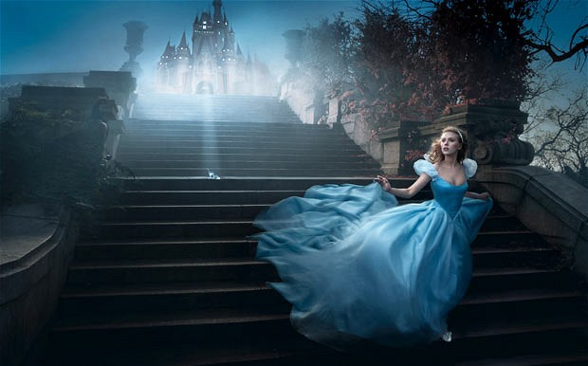
Short Story
A fictional narrative generally centering on one climactic event and usually developing only a single character in depth
Its scope is narrower than that of a novel.
Ex: Cinderella

Slide 19
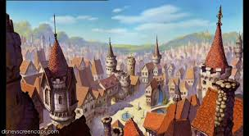
Setting
the historical, physical, geographical, and psychological location where a fictional work takes place: place and time.
Ex: far away land, many years ago

Slide 20
Character
A fictional representation of a person (or animal).
Protagonist
The main character
Ex: Cinderella
Antagonist-
The opponent of the protagonist. The antagonist may be a person, nature, or society.
Ex: Stepmother and stepsisters

Slide 21
Point of view (P.O.V.)
The angle from which a story is told; i.e., the type of narrator the author chooses to use
first-person narration
the narrator uses "I" to tell his or her story
third-person narration
narrators are not actually characters in the story
Narrator uses “he, she, they”

Slide 22
Plot
The way in which the events of the story are arranged.
Beginning → Middle → End
Exposition = background, set-up
Rising action = conflict, problem, crisis
Climax = highest point of tension
Falling action = how things work out
Resolution = result, ending

Slide 23
Conflict
(problem)

Slide 25
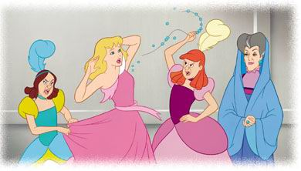
Conflict (problem)
Cinderella wants to attend a ball but her stepmother prevents her from going.
Fairy godmother appears, gives her dress and shoes.
Cinderella goes to the ball, meets the Prince.
She runs away
at midnight.
Shoe falls off.

Slide 27
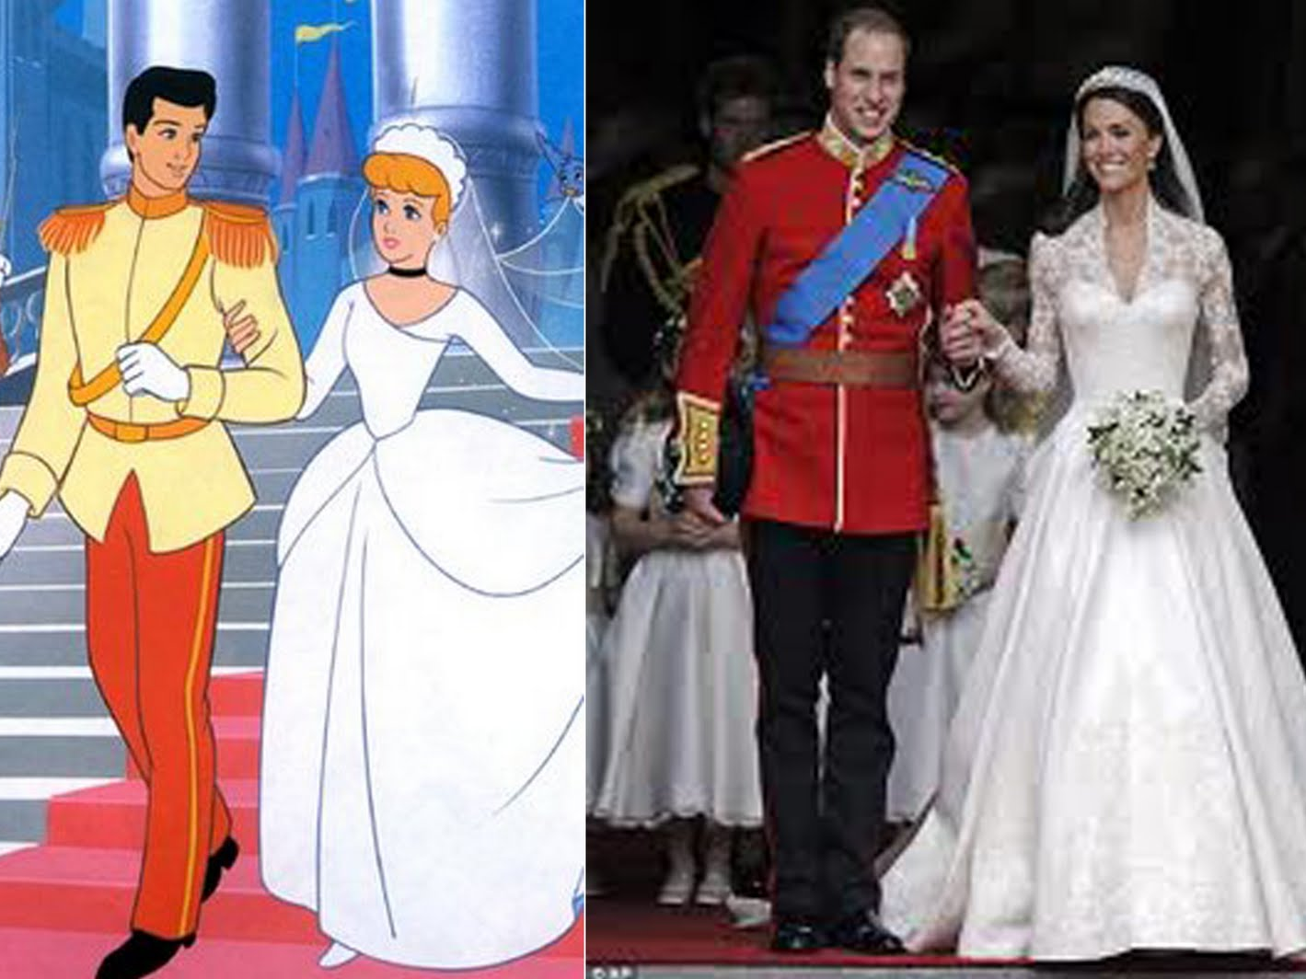

Slide 28
Theme
the central or dominant idea of the whole story
Ex: True love always wins
Ex: Good always wins over evil
Ex: If you do something in secret, it will be made public eventually

Slide 29
Style
the way a writer selects and arranges words to express ideas
Is the language very...
Direct / Indirect
Long / short sentences, descriptions
Realistic / imaginative

Slide 30
Tone
the attitude of the speaker or author of a work toward the subject matter
+ positive, hopeful
0 neutral
- negative, sarcastic

Slide 31
Symbol
Anything that stands for something else, often a thing that stands for an idea.
a red rose
love
broken mirror
bad luck
a calm lake
peace

Slide 32
“An Appointment in Samarra”
Based on the short story, discuss the following literary terms.
Plot
POV
Characters (Antagonist and Protagonist)
Theme
Setting
Style
Tone
Irony

